Slide 1
Australia’s involvement in World War II (1939–1945)
Chapter 7

Slide 2
7.4 The causes and course of World War II
The Treaty of Versailles
More than 17 million soldiers died in World War I and led to the demise of the Austro-Hungarian and Russian Empires
A dictated peace: Germany and their allies were excluded from peace negotiations
The Big Three: the conference was dominated by the leaders of France (President George Clemenceau), the United Kingdom (Prime Minister David Lloyd George) and the USA (President Woodrow Wilson)
All three brought different motives into the negotiations

Slide 3
7.4 The causes and course of World War II
The conditions of the treaty: the harsh conditions were disastrous for Germany who reluctantly signed
The conditions included:
Immediate surrender of all German colonies
Germany to pay reparations of 269 billion marks – designed to keep Germany in debt
An admission of guilt for starting the war – designed to humiliate Germany further
French occupation of Germany’s prosperous Rhineland
Significant restrictions upon the German military – notably limiting the army to 100 000 men while conscription, tanks, heavy artillery and aircraft were all banned

Slide 4
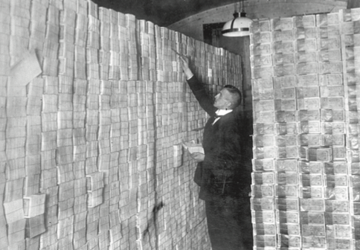
7.4 The causes and course of World War II
Reactions to the Treaty: German people were shocked at the terms imposed
The impact of the Treaty: by 1923, the German government was overspending by seven times and they decided to print more money
Hyperinflation: even with giant piles of banknotes, German people could not afford to buy the basic commodities they needed to survive
In August 1923 new German Chancellor, Gustav Stresemann, was able to restore order by establishing a new currency and negotiating new repayment plans
A banker with piles of bank notes during a time of hyperinflation

Slide 5
7.4 The causes and course of World War II
Fear of Communism: activists were inspired by the writings of German philosopher Karl Marx
The Russian Civil War (1918-1921) resulted in a reign of terror by Josef Stalin
Communism was seen as a threat to democracy, business and personal freedom for individuals
The Great Depression: using loans from the USA and several international banks, Germany managed to briefly stabilise its economy
However, this brief success ended on 24 October 1929, when a stock market crash in New York sparked the Great Depression
Millions of ordinary people around the world were plunged into poverty overnight
The economic suffering in Germany was not noticed by many other nations as countries around the world focussed on their own financial recovery

Slide 6
7.4 The causes and course of World War II
The rise of fascism
The ideas of fascism include authoritarian controls, anti-communism and extreme nationalism
It developed in Italy under Benito Mussolini
Adolf Hitler joined the German Workers Party in 1919 at the age of 30
His charisma propelled him through the ranks to become leader in 1921
Protected from opposition by the violent and paramilitary Sturmabteilung (SA)
The party became known as the National Socialist Party
During the Beer Hall Putsch in 1923, Hitler and other National Socialists attempted a violent takeover of the German Government
Hitler’s arrest and trial gave him a platform to express his political views

Slide 7
7.4 The causes and course of World War II
The rise of the National Socialists: 1928–33
The failure of the Beer Hall Putsch made Hitler turn to legitimate means to gain power
The National Socialist Party: Hitler’s political platform claimed that Germany must rid itself of its ‘impure elements’ in order to restore its strength
Even more than restoring the German economy, Hitler sought to reshape German identity
The four pillars of National Socialist ideology and education:
Nationalism
Lebensraum (living space)
Anti-communism
Antisemitism

Slide 8
7.4 The causes and course of World War II
1. Nationalism: promised to rebuild the military and break the conditions of the Treaty to return a sense of pride to the German people
2. Lebensraum (living space): proposed that Germany needed to expand its borders to make use of the natural resources available in Eastern Europe
Also regarded the Eastern Europeans as ‘racially inferior’
3. Anti-communism: rid Germany of Communism and establish it as a place of more traditional ‘German values’
4. Antisemitism: claimed that Jewish people were the cause of all of Germany’s problems
The ‘Aryan’ race were destined to be the masters of Europe

Slide 9
7.4 The causes and course of World War II
Propaganda
Led by Propaganda Minister Joseph Goebbels, a coordinated media plan was used to sway the thinking of German people
Affordable radios meant National Socialist leadership was broadcast directly into millions of home
Posters were used to reinforce National Socialist ideology
The emerging technology of film was also exploited with grand epics like Triumph of the Will

Slide 10
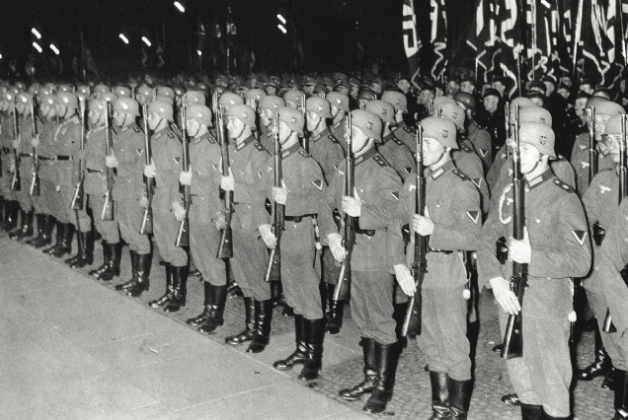
7.4 The causes and course of World War II
Appeasement: 1933-1937
Leaders around Europe adopted a policy of appeasement in order to avoid conflict, allowing Hitler’s agenda to go unchecked
The Nuremburg Laws were passed in 1935 making the ideology of antisemitism a reality
Reforming the Wehrmacht (the German Army) and rebuilding its strength proceeded unopposed
Hitler was allowed to rebuild the German army

Slide 11
7.4 The causes and course of World War II
The failure of the League of Nations: the League’s lack of a unified military meant aggressive states such as Germany could simply ignore the League
The early years of World War II: Blitzkrieg 1939: Blitzkrieg ‘lightning war’ was Germany’s novel war tactic that quickly decimated opposition when it invaded Poland in 1939
The phoney war: however, France and Britain did not retaliate for the Poland invasion until April 1940
By then the Blitzkrieg tactic used on Poland, had been used to threaten both Denmark and Norway who quickly surrendered

Slide 12
7.4 The causes and course of World War II
The western offensive: 10 May 1940 the German armies invaded both the Netherlands and Belgium
On 25 May 1940, the evacuation from Europe was ordered and the German army seemed unstoppable
The miracle of Dunkirk: the British Government put out a call for anyone with access to a boat to sail from England to Dunkirk to rescue stranded British and French troops
Germany managed to conquer France in a matter of weeks
Winston Churchill emerges: newly-elected Prime Minister Winston Churchill gives rousing speech
The Battle of Britain begins (August 1940)

Slide 13
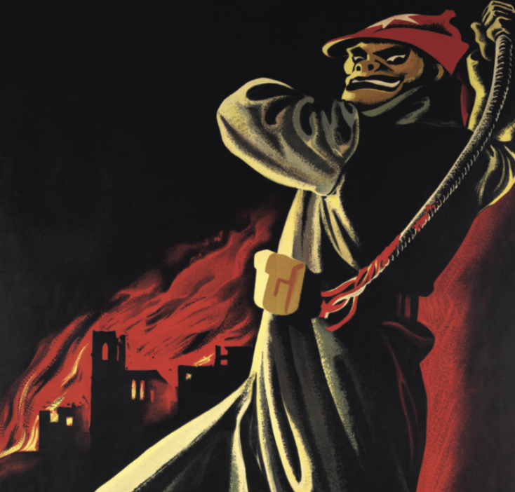
7.5 An examination of significant events of World War II
Operation Barbarossa: 22 June 1941: Hitler broke the Molotov-Ribbentrop pact and ordered the German invasion of Russia
German troops entered Russian territory with the aim of ‘total annihilation’ and against communism and Judaism
They quickly conquered much of Russia, but never managed to capture Moscow
National Socialist anti-Russian propaganda poster

Slide 14
7.5 An examination of significant events of World War II
Pearl Harbor: 7 December 1941: Japanese planes launched a surprise attack on an American military base in Hawaii
This led the United States, who had wanted to continue with its policy of isolationism, to immediately declare war on Japan and enter WWII
The Battle of Stalingrad: August 1942 - February 1943: the defining battle of WWII as Germany sought the vast oil reserves that lay beyond Stalingrad
Russian soldiers ferociously defended the city street by street
Stalin defeated the German forces by executing a pincer movement, encircling the Germans occupying Stalingrad

Slide 15
7.5 An examination of significant events of World War II
Guadalcanal: August 1942 - February 1943: a major turning point in the war against Japan, and an important strategic victory for the US
Placed Japan on the defensive for the remainder of the war
D-Day: 6 June 1944: the Allied invasion of German-occupied France on 6 June 1944 was momentous
Operation Fortitude successfully convinced Hitler that the Allied forces were planning to invade Calais, 300 miles away from the actual site of Normandy, meaning that German defences were insufficient
The fighting was fierce, and the Allied victory spelled the beginning of the end of Germany’s war ambitions

Slide 16
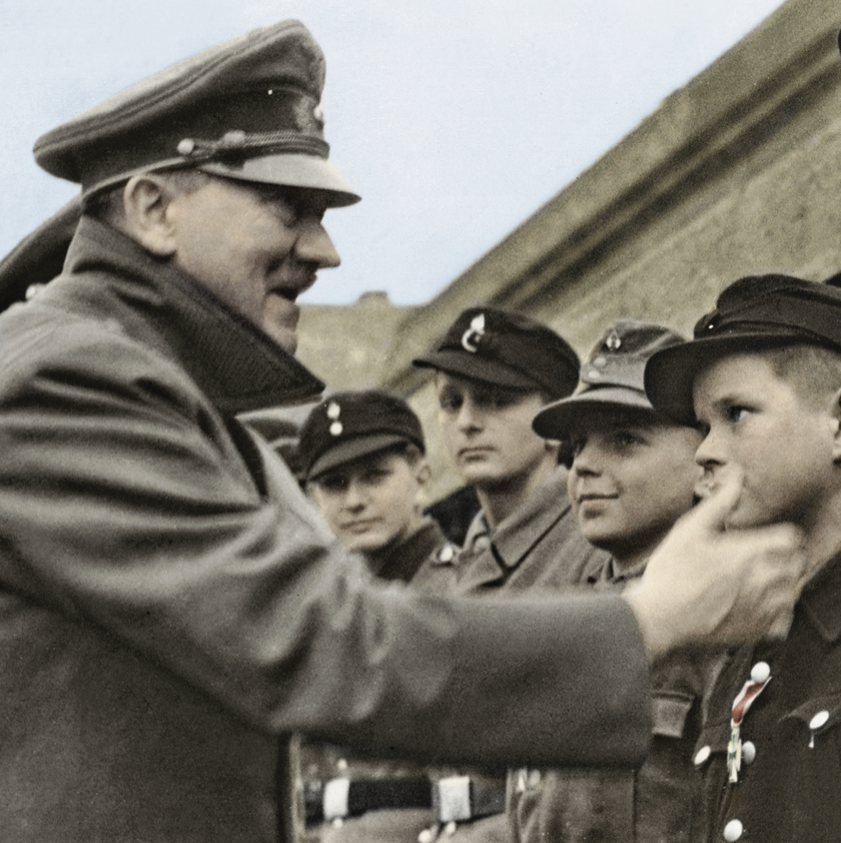
7.5 An examination of significant events of World War II
Berlin in the last days of World War II: April 1945: when the Soviet Army reached the outskirts of Berlin, the German Army’s fighting capacity had been destroyed
Berlin’s defence was left to bands of elderly men and young boys as Hitler’s grasp on the reality of the situation wavered
Hitler and his wife Eva Braun committed suicide on 30 April 1945 in his war bunker
On 8 May 1945, the German army officially surrendered to the Allies, marking VE Day, and the end of war in Europe
Hitler meets members of the Hitler Youth who were left to defend Berlin

Slide 17
7.5 An examination of significant events of World War II
The atomic bombing of Japan: 6 and 9 August 1945: the most devastating weapon the world had seen to date was utilised
Hiroshima, 6 August 1945, 8:15 a.m. Enola Gay dropped an atomic bomb nicknamed ‘Little Boy’, killing 80 000 people
On 9 August 9 1945, a second atomic bomb named ‘Fat Man’ was dropped on Nagasaki, killing 50 000 people
Japanese Emperor Hirohito announced that Japan had surrendered, marking the end of World War II and the end of Japanese imperialism in Asia
Debate still continues over the morality of using the weapons

Slide 18
7.5 An examination of significant events of World War II
Consequences of war: the death toll: in total, 15 million soldiers and 45 million civilians were killed
Millions more would be displaced and never return home
A Cold War between the Soviet Union and the nations of Western Europe would follow
World War II will be remembered for the use of the atomic bomb and the horrific premeditated crime of the Holocaust

Slide 19
7.6 The course of the war and the experiences of Australians in World War II
Introduction
War came to Australia in 1942 with an attack on Darwin
Winding back the clock: before the outbreak of war in Europe, Australia had been slowly recovering from the Great Depression
Australia and the Great Depression: by 1932, more than 60 000 people were dependant on the ‘susso’ (a welfare payment) to live
Gradually, the Australian Government managed to stabilise the nation
Australia prepares for war: in 1939, Australian Prime Minister Robert Menzies sent 20 000 men to support the Allied forces in Europe
This left Australia under the protection of a poorly trained militia of 80 000 volunteers

Slide 20
7.6 The course of the war and the experiences of Australians in World War II
Japanese imperialism: Japanese nationalists believed they were the rightful leaders of Asia and sought to establish a ‘sphere of influence’ throughout South-East Asia
Nanjing: 1937: an estimated 300 000 civilians were tortured and killed, as well as an unspecified number of sexual assaults during the ‘rape of Nanjing’
In 1939, Japan took advantage of the situation in France to launch an invasion of the colonies in Indochina (now Vietnam, Cambodia and Laos)
The Battle of Britain: 1940: Australia was among the countries who sent pilots to Europe to join the fight against the German Luftwaffe
The Blitz in 1940 saw London bombed for 57 consecutive nights
Germany eventually abandoned its invasion plans in October 1940

Slide 21
7.6 The course of the war and the experiences of Australians in World War II
Greece and Crete: April 1941: Australians were deployed to resist German forces
They were soon pushed back and hundreds were killed and captured, though some managed to escape
Tobruk: April 1941: 14 000 Australian soldiers withstood continuous attacks from Germany for 241 days, before being evacuated
They were described by the Germans as ‘rats caught in a trap’ – a title that they took with pride, calling themselves the ‘Rats of Tobruk’
The Fall of Singapore: February 1942: Japan’s air force sank the HMS Repulse and Prince of Wales and marched on Singapore, the core of British power in Asia
After a long and difficult retreat through Malaysia, the Australian, Indian and British forces were eventually overwhelmed by the relentless Japanese Army

Slide 22
7.6 The course of the war and the experiences of Australians in World War II
Australian prisoners of war: Australian soldiers captured after the fall of Singapore were subjected to forced labour and slavery
The Australian and British soldiers were sent to Thailand and Burma to build a rail line for Japanese supplies
A total of 2815 Australian soldiers would die building this rail line
The Bombing of Darwin: 1942: Japan launched a raid of 242 aircraft on the northern city of Darwin
The single most deadly attack on Australian soil, resulting in 235 deaths
This attack came as a shock; WWII was now at Australia’s door
Kokoda: 1942: despite overwhelming odds, Australia was able to defeat Japanese forces on what became known as the Kokoda Track

Slide 23

7.7 The impact of World War II on the Australian home front
Women at work
A shift from Australia’s conservative culture where women usually filled the role of housewives
Women flocked to fill labour roles traditionally filled by men, and excelled in them
200 000 Australian women joined the workforce at this time and their role was vital to the war effort
Australian poster from 1943 highlighting the role of women

Slide 24
7.7 The impact of World War II on the Australian home front
Aboriginal and Torres Strait Islander people in the war: hundreds of Indigenous people signed up to serve in the Australian Imperial Forces
Gunner Percy Suey served in Asia, making many heroic sacrifices for his fellow comrades
He was refused entry to the RSL because of his Indigenous identity
After the war, laws that placed restrictions on the lives of Indigenous Australians meant many of these soldiers were unable to collect the pensions they were entitled to as veterans
Rationing: Bread, butter, meat and even clothing were tightly controlled by a ‘ration book’ system

Slide 25
7.7 The impact of World War II on the Australian home front
Americans in Australia: Thousands of US soldiers were stationed in Australia between 1942 and 1945
Melbourne, Sydney and Brisbane alone hosted 250 000 US troops
Tension arose between Australian and US troops
The Battle of Brisbane: On 26 November 1942, a scuffle between an Australian soldier and an American Military Policeman spiralled out of control
Led to a crowd of 3000 becoming involved and the death of Australian Private Edward Webster
Clashes also broke out in pubs in Melbourne

Slide 26
7.7 The impact of World War II on the Australian home front
Internment camps: built by the Australian Government to house ‘enemies’ who could be a danger to national security
Initially only housed people who were legitimately threatening, but later thousands of Japanese civilians were arrested and imprisoned
The Cowra Breakout: in Cowra, a town in rural New South Wales, about 700 Japanese prisoners of war escaped
After nine days, 231 were killed, 108 were wounded and 344 were recaptured
Children and war: Australian children were largely protected from atrocities such as carpet bombing which happened in Europe
Raised to fear the Japanese ‘monsters’ as they saw them in propaganda and experienced hardship from rationing and estrangement from their fathers

Slide 27
7.7 The impact of World War II on the Australian home front
Post-war immigration: as a country far away from the horrible memories of Europe, Australia became an attractive destination for war refugees to begin a new life
Widely supported by the population in order to rebuild the country’s economy
Started with the British followed by people from Eastern Europe, Holland and Belgium and large groups of Greek and Italian families
The Snowy Mountains Hydro-Electric Scheme: utilised almost 100 000 postwar migrants from over 30 countries over 25 years

Slide 28
7.8 An examination of a significant event of World War II: the Holocaust
During World War II, approximately 15 million people – including six million Jewish people – were murdered
Many Germans were involved in this process and millions more stood by as it happened
Origins of the Holocaust: The Holocaust refers to the collective anti-Jewish actions by the Nazi regime between 1933 and 1945, stripping them of legal and economic status
It is argued the anti-Semitic origins of the Holocaust emerged well before Hitler took power and is based on the belief that Jewish people killed Jesus
Hitler attempted to bolster this argument with pseudoscientific notions of eugenics and social Darwinism

Slide 29
7.8 An examination of a significant event of World War II: the Holocaust
The legislation of the Holocaust: 1933–45
Dachau, the first concentration camp, opened in 1933
Anyone believed to not be conforming to Nazi ideology was arrested and condemned to hard labour in Dachau
Dachau was soon filled with 15 000 political prisoners
The Nuremburg Laws of 1935 were made to decimate the rights of Jewish people in Germany, segregating them from regular society
Jewish people were forced to carry identity cards, barred from working in government roles, from teaching in German schools and from marrying people who were determined to be non-Jewish

Slide 30
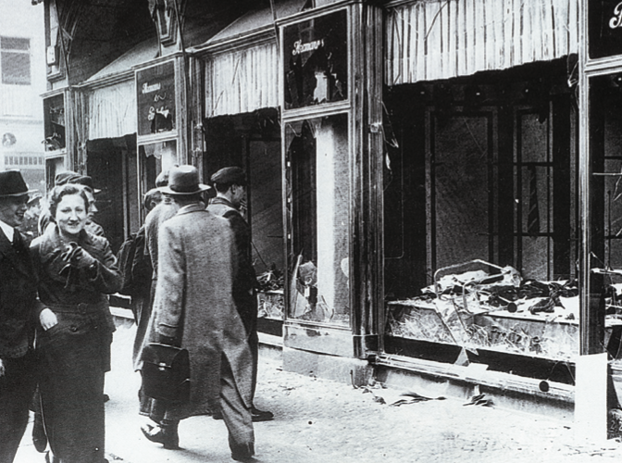
7.8 An examination of a significant event of World War II: the Holocaust
Kristallnacht: 9 November 1938
English translation: ‘the night of broken glass’
Over three nights, more than 7000 Jewish-owned businesses were destroyed, and 200 synagogues were set alight
100 (believed to be much greater) Jewish people were beaten and killed, although many of the deaths were not registered by German authorities.
The graves of almost 30 000 Jewish people were vandalised
The broken windows of a Jewish-owned shop in Berlin after Kristallnacht

Slide 31
7.8 An examination of a significant event of World War II: the Holocaust
Sterilisations and euthanasia: by 1934 up to 400 000 Germans had been forcibly sterilised
The euthanasia program targeted ‘feeble-mindedness’, people with a disability and people housed in mental hospitals
The Final Solution: 1939–45: Germany’s invasion of Poland in 1939 meant the largest Jewish population in Europe (3.3 million) was now under the direct control of the fascist Nazi regime
Jewish people were deported to sealed ghettos in larger cities, where conditions were squalid

Slide 32
7.8 An examination of a significant event of World War II: the Holocaust
From imprisonment to murder: when the German army invaded Russia, the normal rules of war did not apply
The Einsatzgruppen: groups of soldiers that acted as mobile killing units
Would enter a town as the conquering German army left
Tasked with murdering Jewish people on a massive scale (1.5 million in total)
Babi Yar: a ravine outside Kiev, Ukraine where 33 000 Jewish people were executed
Odessa: a city in Ukraine where 5000 Jewish people were shot in city streets
Around 20 000 Jewish people were also herded into bunkers which were doused with gasoline and set alight

Slide 33
7.8 An examination of a significant event of World War II: the Holocaust
Mobile gas chambers: used by the Einsatzgruppen as a less ‘expensive’ alternative to bullets
By 1943, the Einsatzgruppen had ceased operation, as the use of poison gas and concentration camps was in full swing
Wannsee Conference: January 1942: a conference to discuss the ‘Final Solution’
Heinrich Himmler: leader of the Schutzstaffel (SS) and commander of the Einsatzgruppen
Himmler was concerned about the financial cost of the mass murder of Jewish people and it was decided all Jewish people in German-occupied European countries would be transported to concentration and death camps
The largest of these death camps was Auschwitz-Birkenau

Slide 34
7.8 An examination of a significant event of World War II: the Holocaust
Transportation and ‘liquidation’: 1941–43: Jewish people all over Europe were rounded up and sent to camps in Germany and Poland
The Warsaw Ghetto Uprising: April–May 1943: A few hundred of the 50 000 residents formed a resistance group and attempted to defend the ghetto against the SS who entered on the eve of Passover to ‘liquidate’ the remaining residents
The uprising was defeated when the SS burned the ghetto down building by building
The battle killed 7000 residents; the remainder of the residents were flushed out and captured, and a further 7000 were sent straight to their deaths at Treblinka death camp

Slide 35
7.8 An examination of a significant event of World War II: the Holocaust
Life in the camps: Process of selection decided who could work and who was killed straight away
‘Work sets you free’: The motto ‘Arbiet Macht Frei’ (work makes you free) was on the gates that hung over the entrance of the Auschwitz concentration camp
Life in the camps was a daily struggle of torture, brutality and degradation
The machinery of death: At its peak, Auschwitz was killing and cremating over 4000 prisoners per day
Death Marches and cover-ups: As the war turned against Germany in 1943, there was a desperate race to cover up the atrocities of the Final Solution
Death marches killed tens of thousands of people
Soldiers were ordered destroy gas chambers and other evidence of crimes

Slide 36
7.8 An examination of a significant event of World War II: the Holocaust
Liberation: camps were liberated throughout 1945 but physical and emotional scars of these experiences would be with the survivors forever
The Nuremburg trials: throughout 1945–1946, 199 top German Government officials were charged with their involvement in the systematic murder of civilians
Several high-ranking members of the National Socialist Party committed suicide before they reached trial
Concentration camp guards, collaborators and officers were later hunted across the globe
The righteous among the nations: people who risked their own lives to protect Jewish people from persecution

Slide 37
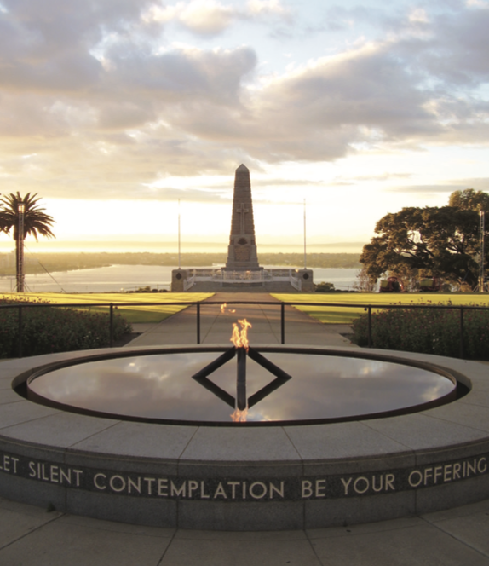
7.9 Conclusion: why does it matter?
Study World War II to help understand the nature of human conflict on a mass scale
Learn about the extremities of war, hatred and racism
Recognise the conditions and factors that cause people and nations to resort to extreme solutions
Also understand how Australia forged a new identity and a new place in the world in the midst of this war
The Eternal Flame in Kings Park Perth, Western Australia

